Slide 1
CSIR-10

Slide 2


Slide 4
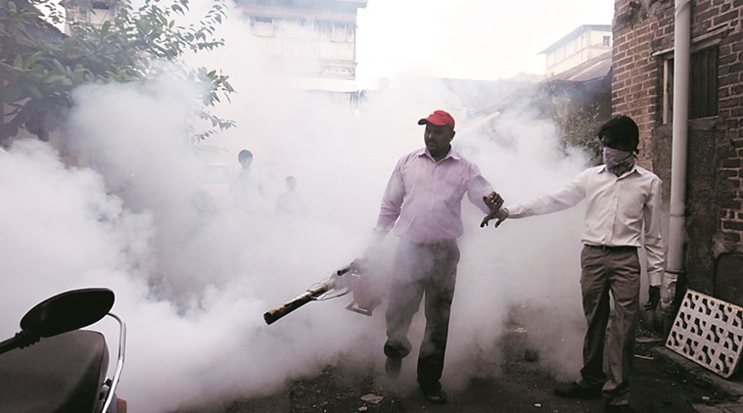
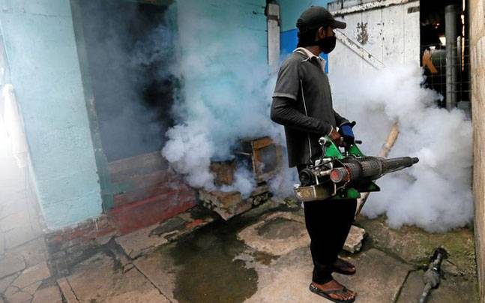

Slide 5

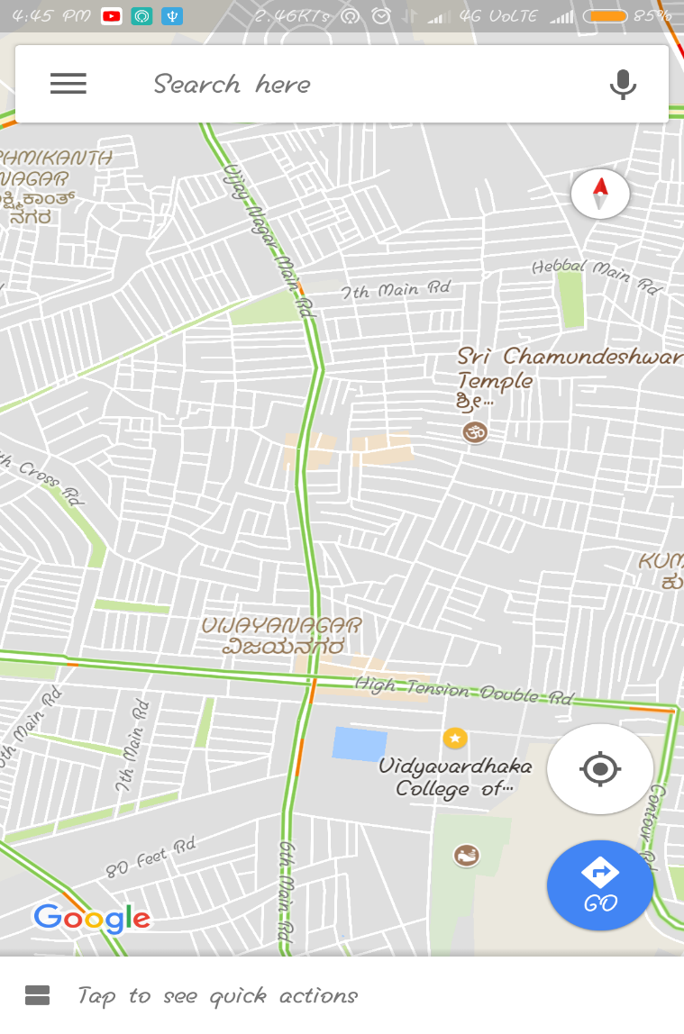

Infected region

Slide 6

Dengue density
Locator and predictor

Slide 7
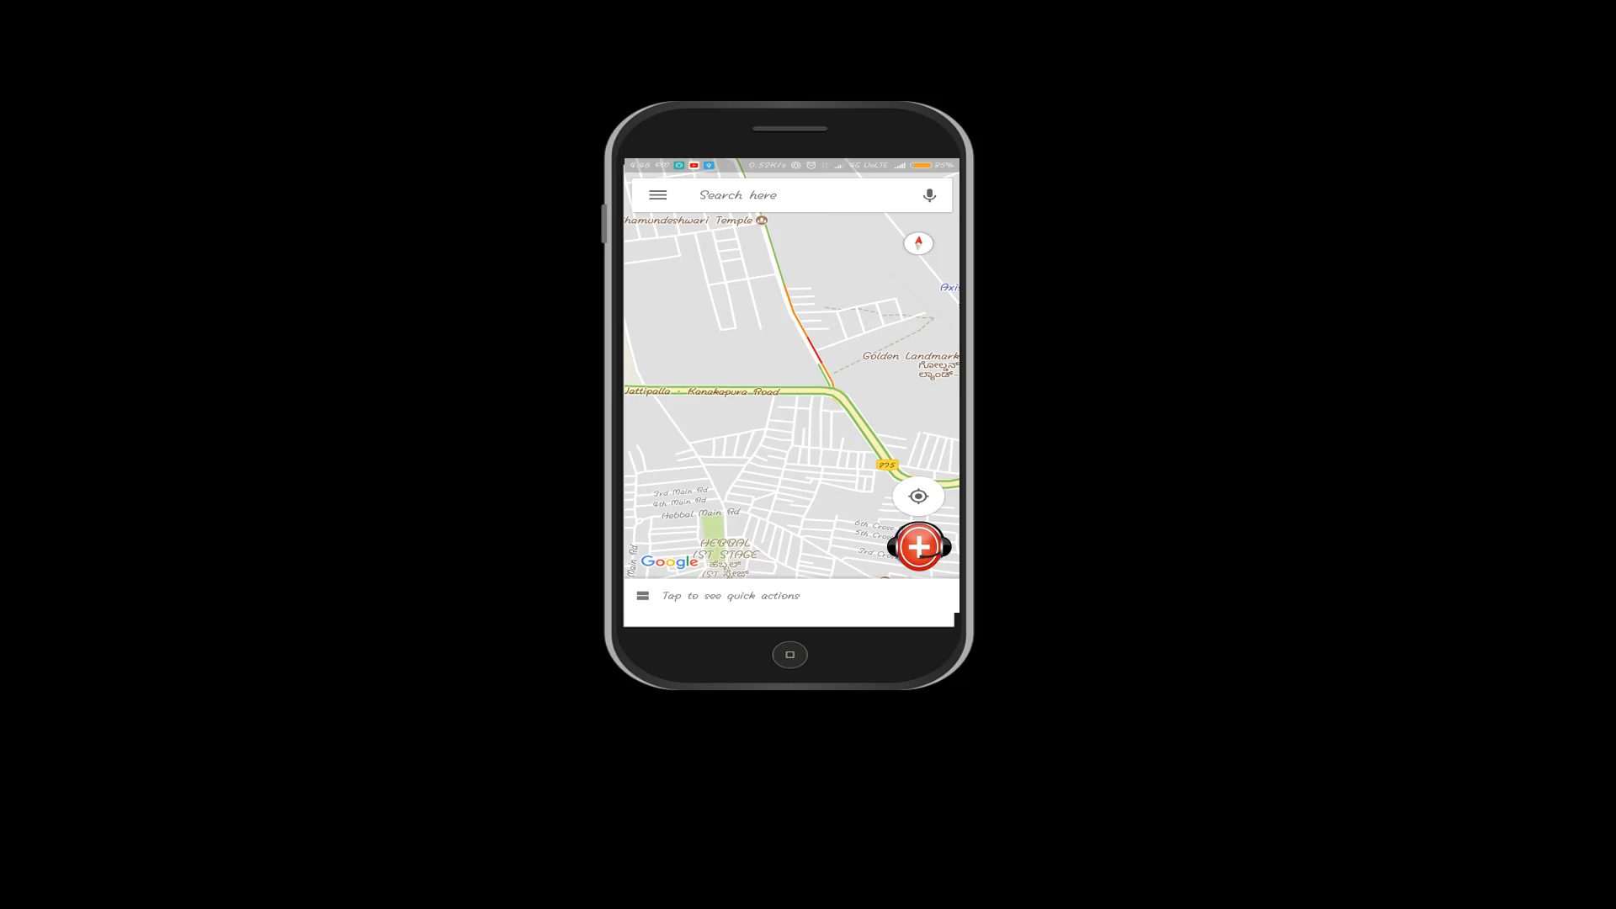
Dengue density
Locator and Predictor

Slide 8

Dengue density
Locator and Predictor

Slide 9
Dengue density
Locator and Predictor
Emergency
ambulance

Slide 10
Dengue density
Locator and Predictor
Emergency
ambulance

Slide 11
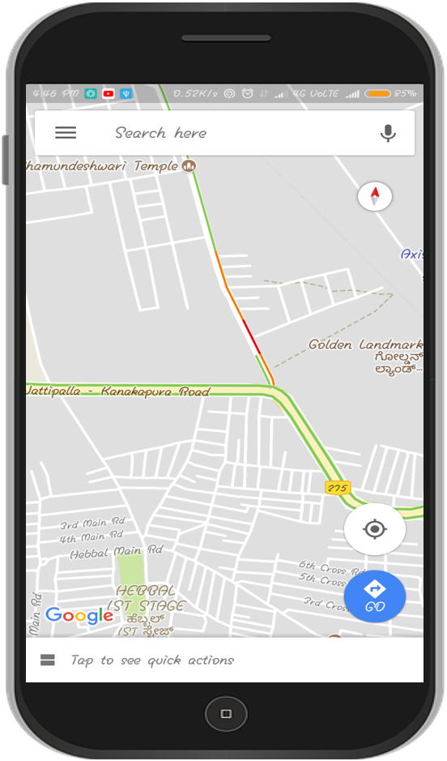


Showing Location of the user
Showing location of the nearby Pharmacy
Showing location of the nearby clinic

Slide 12


Slide 13
Dengue density
Locator and Predictor
Emergency
ambulance
Location access

Slide 14
Dengue density
Locator and Predictor
Emergency
Ambulance
Location access

Slide 15

DENGUE TERMINATOR

Slide 16
Sign up for public user :
Name
Sign up
Password
Confirm Password
Aadhaar no.
Mobile no.
Sign up

Slide 17
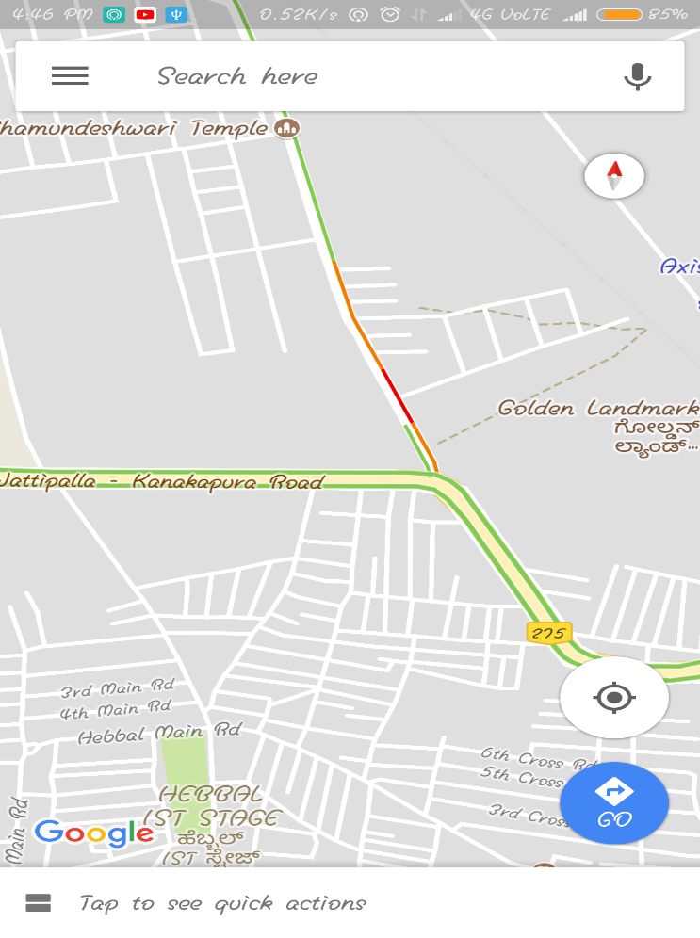
I N T E R F A C E L O O K L I K E T H I S
Showing Location of the user

Slide 18
Sign up for clinic :
Clinic name
Password
Confirm Password
S i g n u p
License no.
Mobile no.
Sign up

Slide 19
I N T E R F A C E L O O K L I K E T H I S
Showing location of the clinic

Slide 20
Sign up for pharmacy owner :
pharmacy name
Password
Confirm Password
S I g n u p
License no.
Mobile no.
Sign up

Slide 21
I N T E R F A C E L O O K L I K E T H I S
Showing location of the Pharmacy

Slide 22


I HAVE A DOUBT !
For security purpose “In case of creating new fake clinic account” ?!
Avoidable
Showing location of the Fake clinic
Showing location of the clinic
To prevent unauthorized people log in as a doctor or creating fake clinic account , we ask them(
to provide the necessary proof like certificates and after authorization only , we will update this into our system.

Slide 23
But how can we find density of dengue 🤔

Slide 24
Asking user about his surrounding cleanliness :
How clean is your surroundings?
Give your answer here
Asking question to user
User ID:
OK

Slide 25
Asking DOCTOR about his PATIENT DETAILS :
Section for the doctor to enter patient’s user ID

Slide 26
W E A R E U S I N G A A D H A A R I D”

Slide 27


Aadhaar id
User Identification

Slide 28
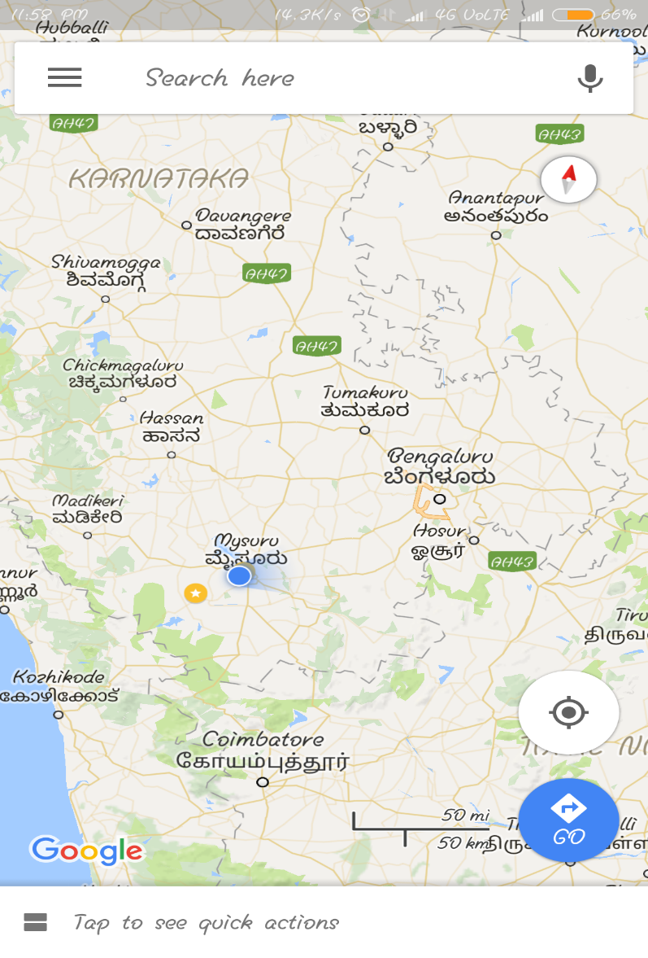
DATA BASE
SEARCH FOR THAT
PATIENT’S USER ID
AND CORRESPONDING HOME LOCATION
ENTER ID HERE
SUBMIT

Slide 29
Updating cured patient details
WE ARE GOING TO ASK THE HEALTH CONITION OF THE PATIENTS
OK

Slide 30
Updating the density of dengue in map

Slide 31
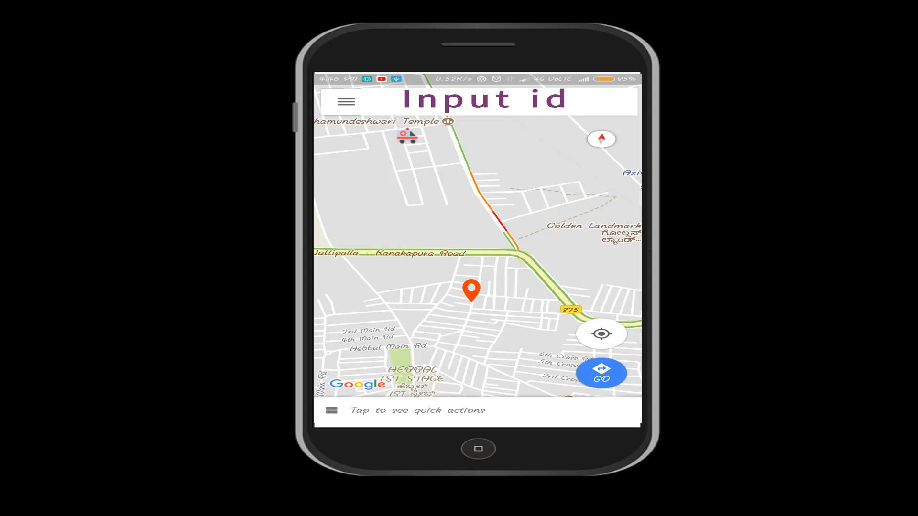

Slide 32
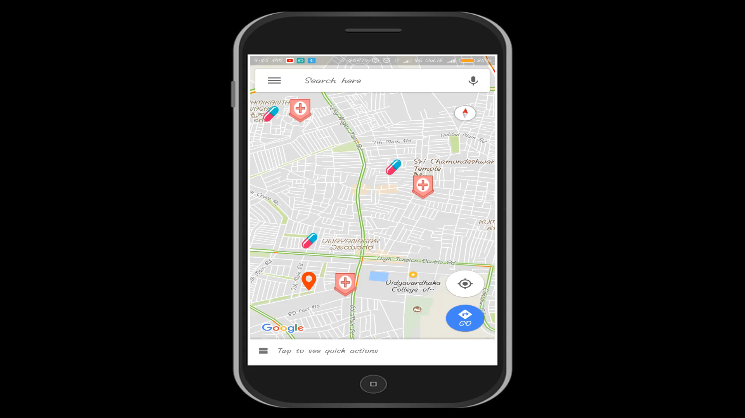

Slide 33
DENSITY OF DENGUE
(DISTRICT WISE)
=
NUMBER OF DENGUE INFECTED PEOPLE IN THAT DISTRICT
X 100
NUMBER OF DENGUE INFECTED PEOPLE IN THAT STATE

Slide 34
ALGORITHM FOR DENGUE PREDICTION

Slide 35
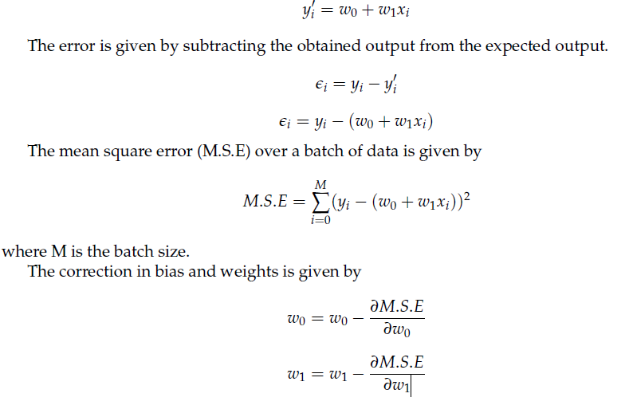

Slide 36
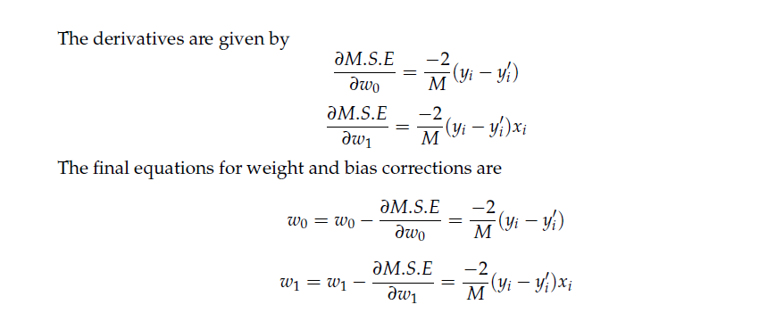

Slide 37
THANK YOU

